Slide 1

PROJECT ON FLATLOCK

Slide 2
OBJECTIVE
Learning & Resolving issues occurred in Knits due to Roping and Puckering.

Slide 3
PROJECT PROCESS FLOW
Collected defects samples from store.
Statistical data based on store visits.
Shortlist Vendors for factory visit.
Vendor selections based on
On statistical data of vendor and
On variety of fabric handling capacity of vendor
Analysis of major defects- categorize manual and machine error.
Discuss and solve defect accordingly

Slide 5
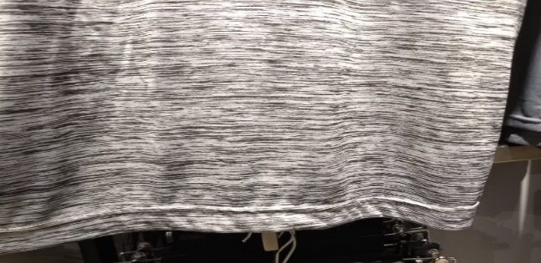
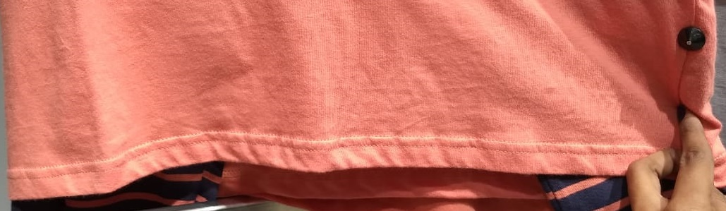
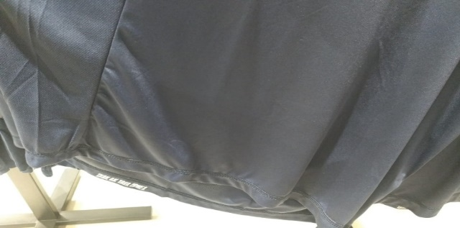
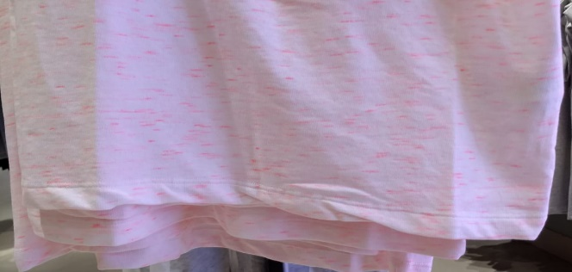
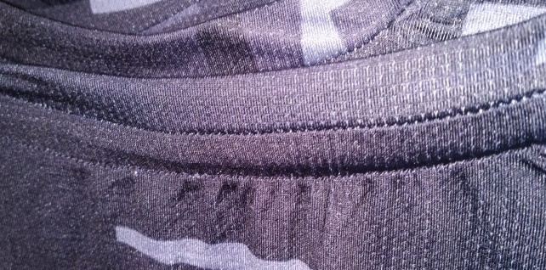
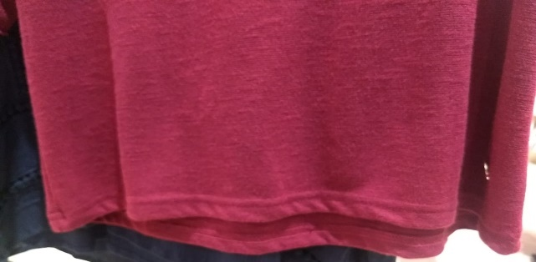
CONSTRUCTION DEFECTS

Slide 6
VENDOR VISIT ITINERARY
Analysis major and minor defects
Categorize manual and machine error.
Conclusion made accordingly with team.
Resolved defect based on category

Slide 7
SEAM PUCKERING & ROPING?
Undesirable seam appearance to the garment.

Slide 8
REASONS PUCKERING & ROPING
Pressure foot and feed dog.
Sewing thread tension.
Sewing thread contraction.
Diameter of sewing thread and needle.
Differential shrinkage.

Slide 9
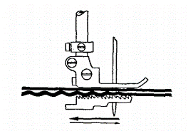
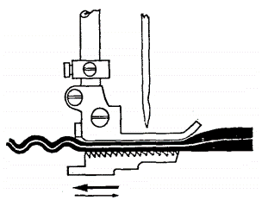
PRESSURE FOOT AND FEED DOG
Caused by-
Pressure of the presser foot.
Alignment of feed dog.
Displacement between fabric layers.
Apart from the above factors there are others such as the operator's skill, mismatched fabric, etc. which may also lead to seam pucker.

Slide 10
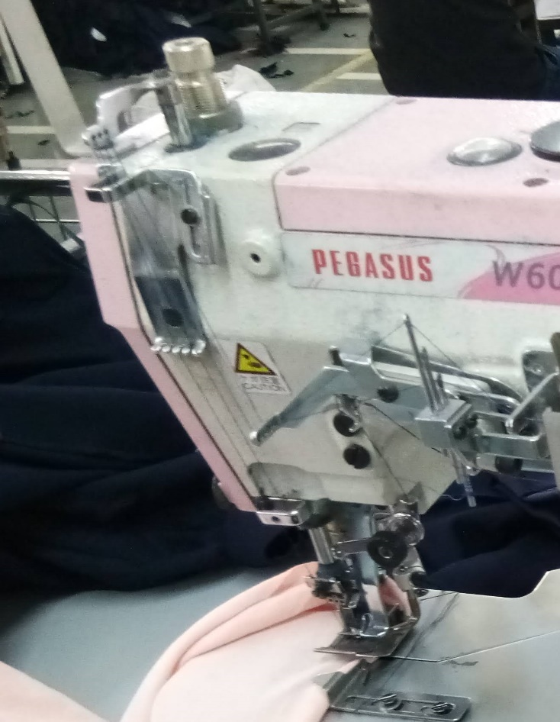
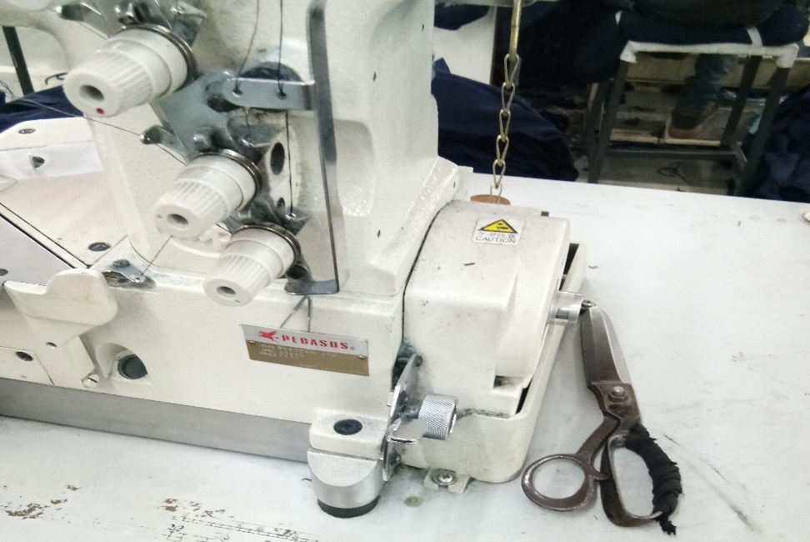
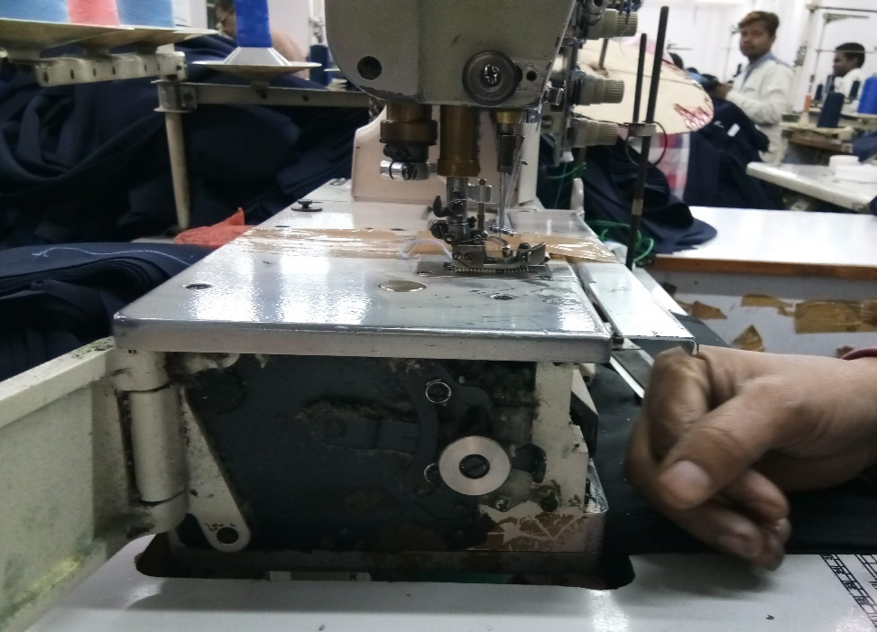
1
PRESSURE FOOT ADJUSTMENT
FEED DOG ADJUSTMENT
Notes:
HIGHER THE FEED DOG FOR LOW GSM & VISA VERSA

Slide 11
REMEDIAL MEASURES
The presser foot pressure exerted on the fabric should be relevant to fabric to keep up uniform feeding.
Setting of feed dogs with respect to their height
The selection of feed dog with reference to the number of teeth per inch.
20–24 TPI (teeth per inch) for lightweight fabrics,
14–18 TPI for medium weight and
8–12 TPI for heavy weight fabrics are normally preferred.
The presser foot and needle plate should have comparatively small needle holes with respect to the needle size being used.

Slide 12
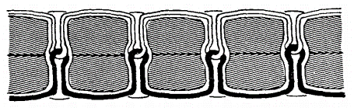
SEWING THREAD TENSION
Seam pucker due to sewing thread tension
Needle thread tension
Spreader thread tension
Excessive sewing thread tension will not only lead to seam puckering but also cause other problems such as skipped stitches and sewing thread breakage.

Slide 13
REMEDIAL MEASURES
To avoid this type of seam pucker the sewing thread tension should be kept at the minimum practical level.
Optimise needle thread and spreader thread tensions.
Synchronisation of timing of feeding has to be set correctly as incorrect feed timing can lead to the need to apply excessive tension to the needle thread, in order to create a properly balanced stitch.

Slide 14
SEWING THREAD CONTRACTION
During sewing the sewing threads are under some tension.
When the thread tension is relieved, the threads start to contract, resulting in a decrease in stitch length.
If the decrease in stitch length is greater than the contraction of fabric within the stitch, the seam will pucker.
The amount of thread elongation and contraction depends on sewing thread composition and tension.
To reduce this type of seam pucker the sewing thread tension should be kept very low.

Slide 15
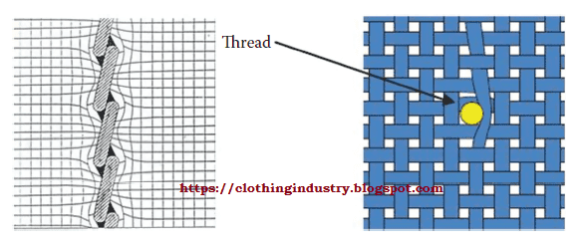
DIAMETER OF SEWING THREAD AND NEEDLE
Sewing threads and needle can also cause seam pucker when the geometry of the fabric is such that there is insufficient space to accommodate the needle or sewing thread or both (known as swelling).
It can be avoided using a fine needle, suitable stitching thread count or both.

Slide 16
REMEDIAL MEASURES
Use of finer sewing thread which will retain sufficient seam strength.
Use of finer needles that will not lead to sewing problems.
SPI (stitches per inch) should be reduced, hence less yarns are exiled from the stitch line.

Slide 17
SPI/ STITCHING THREAD/ NEEDLE
Bottom hem, sleeve hem, waist band , neck top etc. top stitches are generally used 10-12 SPI
FABRIC TYPE | NEEDLE | SPI
HEAVY FABRIC (200-260) | 11 | 10-12
LIGHT FABRIC (140- 180) | 9 | 12-14

Slide 18
SPI/ STITCHING THREAD/ NEEDLE
For needle - polyester thread / cotton poly
For looper - polyester/ filament thread.
Especially for yarn dyed / over dyed garments use 100% cotton for looper and needle.

Slide 19
DIFFERENTIAL SHRINKAGE
Differential shrinkage may take place between -
Fabric layers
Fabric and thread, or the seam and another component joined to it, e.g. a interlining, zipper tapes, stay tapes and the thread.
It may occur immediately after sewing, after some relaxation, during wear, or after laundering.
Wash pucker: sewing thread shrinks during the washing process, it pulls the fabric with it causing puckering.
Ironing pucker: It occurs while using synthetic sewing threads in the garment. The application of heat changes the molecular structure of the fibres in the thread, which results in shrinkage leading to puckering.
The only way to reduce or avoid this is the use of compatible components in terms of dimensional stability.

Slide 20
CONCLUSION

Slide 21
PUCKER TYPE | IDENTIFY | COMMENTS
PRESSER FOOT AND FEED DOG | “Z” roping occur due to excess pressure on presser foot. “S” roping occur due to feed dog position is higher than requirement. Wavy hem (eg: jogger rib joint at bottom) | Ensure presser foot is at minimum level to avoid “Z” roping. Feed dog alignment to be as per gsm to avoid “S” roping. Both presser foot and feed dog to be aligned as per gsm to avoid wavy hem. Machine maintenance is must Correct operator technique while stitching.
SEWING THREAD TENSION | Seam cracking or loop formation. Mount formation at front side. | Sew with minimum needle thread tension loop our formed. Sew with maximum needle thread tension after seam is cracking. Mount is forming due to loose lopper thread tension, need to adjust before stitching. Before stitching machine adjustment is must.

Slide 22
PUCKER TYPE | IDENTIFY | COMMENTS
SEWING THREAD CONTRACTION | Puckering at stitching thread both sides. | -Adjust thread tension based on fabric GSM and STRUCTURE.
DIAMETER OF THREAD AND NEEDLE | Pucker effect -Fabric holes | Use suitable needle, suitable stitching thread count to avoid fabric hole issue .
DIFFERENTIAL SHRINKAGE. | Puckering at one of both the panels/ element | Adjust feed dog as per base fabric and presser foot as per other element.

Slide 23
THANK YOU

